Slide 1

Teaching a Self-
Driving Car to
Cross Safely​
Jiaqi Xie
25027138
Notes:
Cover title slide layout features a full background image with a main heading positioned in the top left corner on a dark purple panel. The presenters’ names and the date sit beneath the title. The UCL logo is placed in the bottom right corner of the slide.

Slide 2
Area of research
Safe decision-making for self-driving cars at intersections
A self-driving car must decide what to do next. Other cars may move in more than one possible way.
In simple words, I am studying how a car can cross a busy junction without being too brave or too scared. The car should move forward, but only when the possible futures of nearby cars look safe enough.
TV
EGO
Like crossing a road: look, think, then move.
Notes:
Content slide with a headline at the top left, followed by text box beneath it.

Slide 3
Problem
One guess is not enough
One guessed future
Several possible futures
EGO
TV
EGO
TV
Too confident
More careful
The problem is uncertainty. If the self-driving car only trusts one guessed path, it may make a risky decision. A safer car should think about several possible futures, just like a person checks both directions before crossing a road.
The challenge: choose a move that is safe for many possible futures.
Notes:
Content slide with a headline at the top left, followed by text box beneath it.

Slide 4
Significance
A good car should be safe, not stuck, and not uncomfortable
Safe
Keep moving
Smooth ride
Too brave: possible crash.
Too scared: the car may stop and block traffic.
Too rough: passengers feel uncomfortable.
This matters because real junctions are busy and confusing. A good autonomous car must balance three simple goals: avoid danger, keep moving, and make the ride feel smooth for passengers.
Notes:
Content slide with a headline at the top left, followed by text box beneath it.

Slide 5
State of the art
What existing methods often do
Proposed idea
Some planners follow one predicted path.
Learning models can show many possible futures.
The hard part is using these futures safely.
Use several predicted futures.
Give each future a safety budget.
Re-plan again at every step.
I am trying to connect prediction and control. Instead of treating prediction as one fixed line, it lets the car see multiple possible futures and then uses a careful planner to choose an action that keeps risk low.
Notes:
Content slide with a headline at the top left, followed by text box beneath it.

Slide 6
Hypothesis
My test idea
If the car plans with several possible futures, it should cross the junction more safely than a weaker planner.
How I test it
Compare the main careful planner with simpler baselines.
Measure whether the car finishes, keeps distance, and moves smoothly.
Scenario
Simulator
Possible futures
Safe planner
Action
Results
Notes:
Content slide with a headline at the top left, followed by text box beneath it.

Slide 7
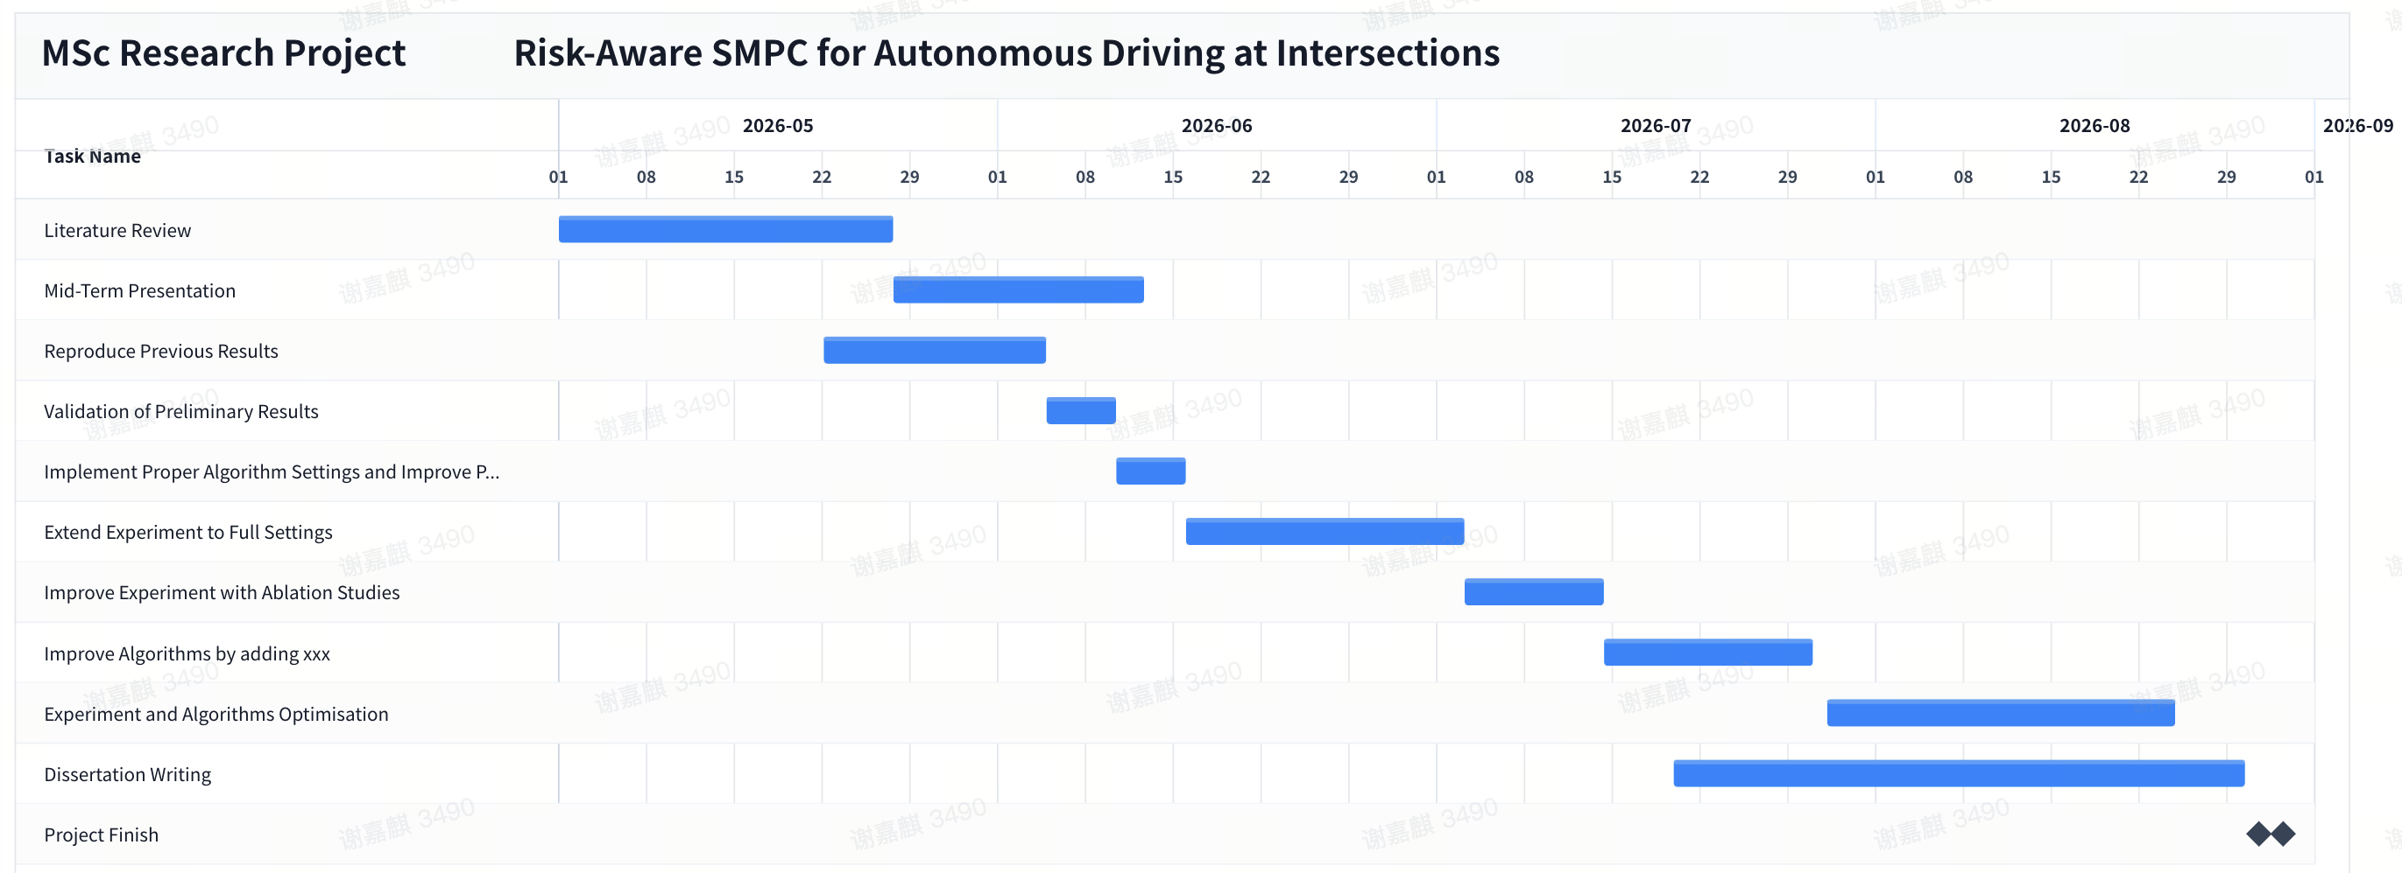
Execution plan
Notes:
Content slide with a headline at the top left, followed by text box beneath it.

Slide 8
Risk analysis
Risk | Why it matters | My response
Simulator is slow | Experiments take time | Run small pilots first
Planner fails | Car may not move safely | Save debug files
Path is not neat | Results look weak | Tune tracking
Too few tests | Claims are not strong | Scale gradually
The biggest risk is not only whether the car can finish once. I also need to show that it can finish reliably, with a reasonable path, across more starting conditions. This is why I am using small pilots before full experiments.
Notes:
Content slide with a headline at the top left, followed by text box beneath it.

Slide 9
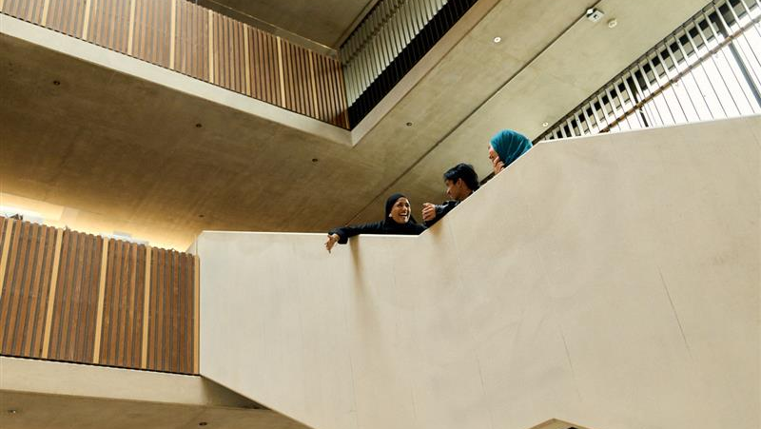

Notes:
Content slide full image with full colour logo

